Slide 1
AIRbnb Case study Data Story Points
By,
Pushpaank Srivastava
Chenamma Priya rangaraj
Aastha parihar

Slide 2
Objective
Airbnb is an online platform using which people can rent their unused accommodations.
For the past few months, Airbnb incurred a huge loss in revenue.
People have now started travelling again and Airbnb is aiming to bring up the revenue again and be ready to provide services to customers.

Slide 3
Background
For the past few months, Airbnb has seen a major decline in revenue.
Now that the restrictions have started lifting and people have started to travel more.
Airbnb wants to make sure that it is fully prepared for this change.

Slide 4
Data Analysis
In the first phase, the data is captured and loaded into various environments.
Once data is cleaned, EDA is done and new features are created.
Then Meaningful insights are derived using various analytical methods.

Slide 5
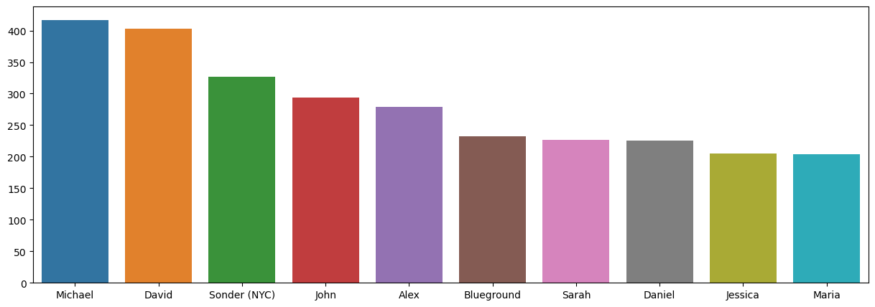
Univariate analysis Michael is the popular host and has been booked most number of times (i.e.) 417

Slide 6
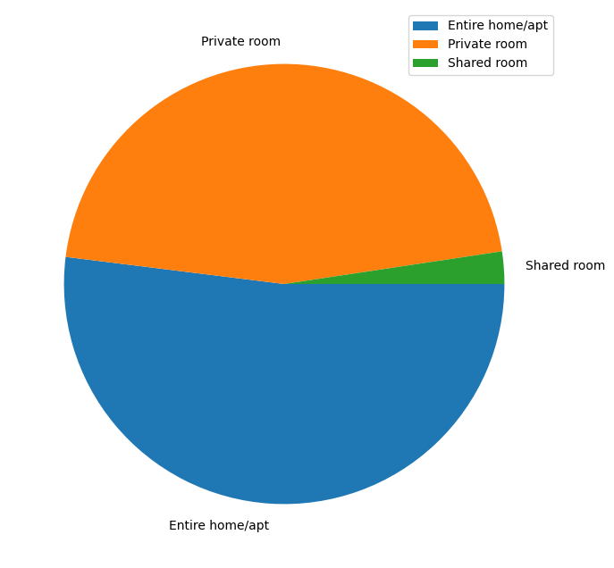
Preference of Room Type There are three types of rooms – 1. Entire home/Apartment 2. Private room 3. shared room Overall, customers appear to prefer private rooms (45%) or entire homes (52%) in comparison to shared rooms (2.4%).

Slide 7
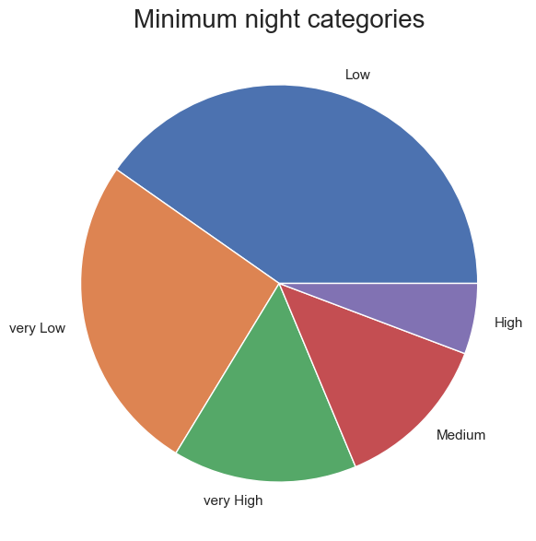
Minimum Night categories Customers prefer to leave reviews for lower number of minimum nights

Slide 8
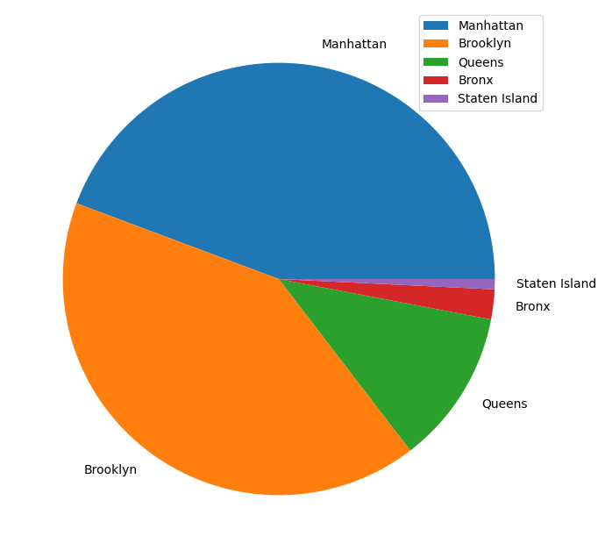
Neighborhoods 1. Manhattan and Brooklyn has the highest neighborhood contribution. 2. Staten Island has the lowest contribution.

Slide 9
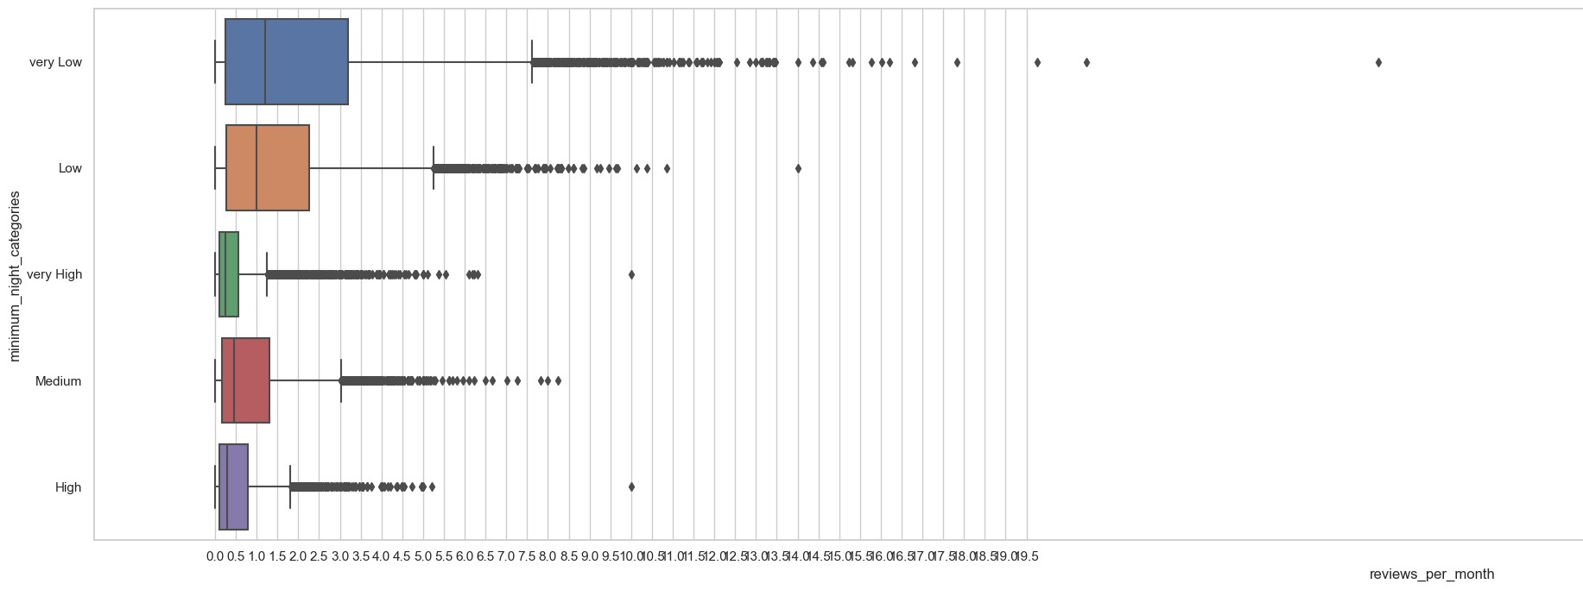
EFFECT OF MINIMUM NIGHT ON REVIEWS Customers are more likely to leave reviews for lower number of minimum nights.

Slide 10
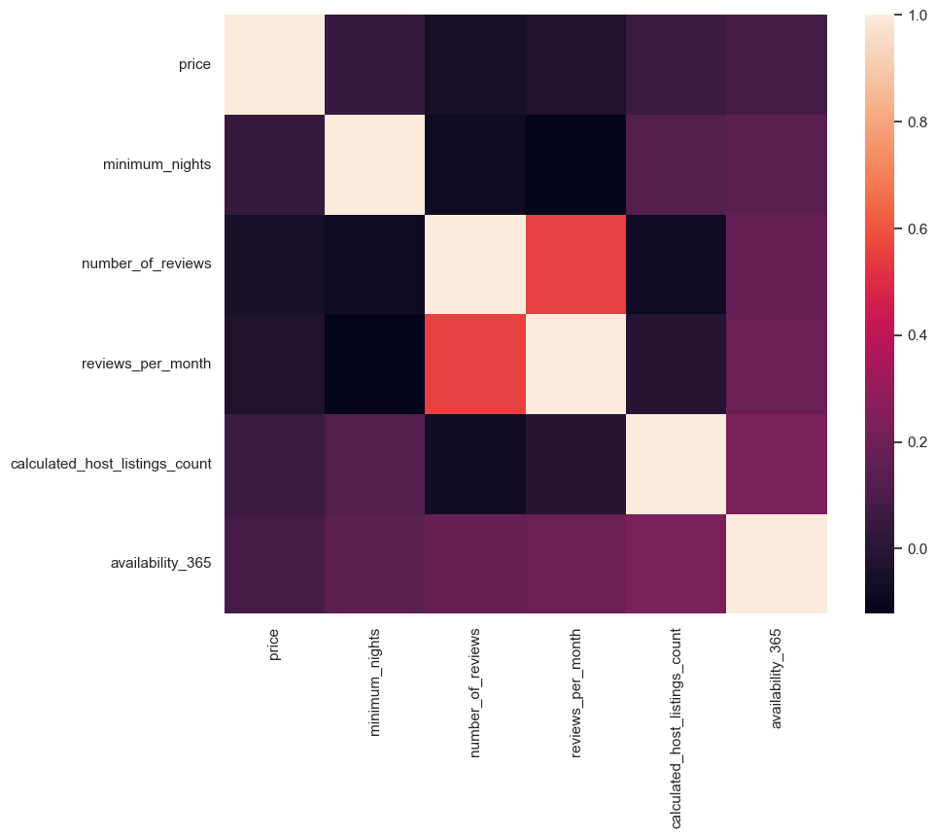
Multivariate analysis Insights from the correlation between reviews and other factors might be useful in targeting marketing efforts to boost bookings for listings that are lagging in performance.

Slide 11
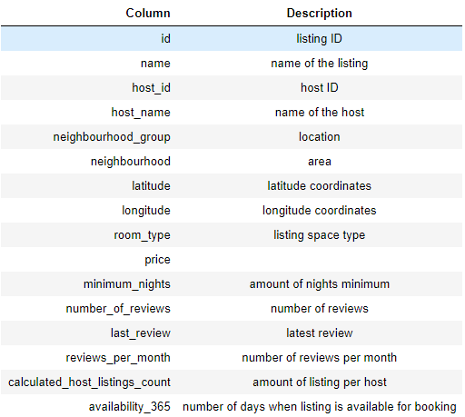
Data Source You can refer to the below to get a better idea of what each column signifies.

Slide 12
Data Methodology

Slide 13
Recommendations
Shared rooms need to be inspected upon.
The cumulative contribution of all hosts is better than a few hosts doing well.
More than 80 % of the listing are Manhattan and Brooklyn neighborhood group
Minimum nights threshold should be on the lower side to make properties more customer-oriented

